Slide 1
Chapter 19
SOUND WAVES

Slide 2
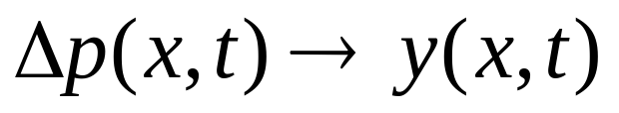
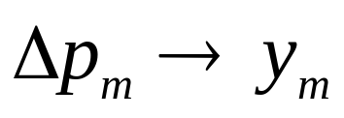
SOUND WAVES
Longitudinal waves
Frequency range 20Hz to 20000Hz
y
x
Wave function y = y_{m}sinω(t –x/u)
y = y_{m}sin(ωt -kx)
k=ω/u
SOUND WAVES
Δp(x,t) = Δp_{m}sin(kx- ωt )
change pressure

Slide 3
SOUND WAVES
Longitudinal waves
Frequency range 20Hz to 20000Hz
y
x
ΔP = -B ΔV/V, (B bulk modulus)
Δp(x,t) = Δp_{m}sin(kx- ωt )
Change in pressure
ρ= m/V
= Δp ( ρ /B)
Δρ = - (m/V²)ΔV = - ρ (ΔV/V)
Δρ_{m} = Δp_{m} ( ρ /B)
Δρ(x,t) = Δρ_{m}sin(kx- ωt )
Change in density

Slide 4
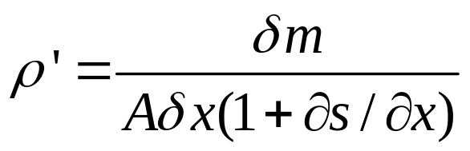
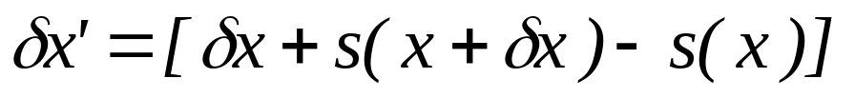
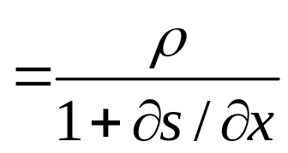
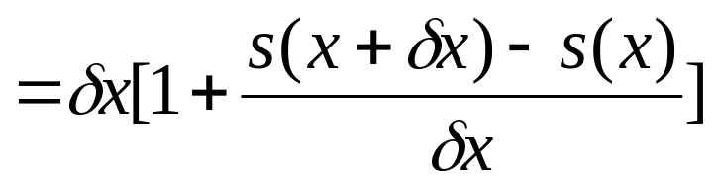


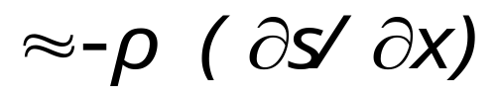

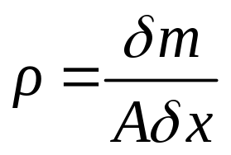
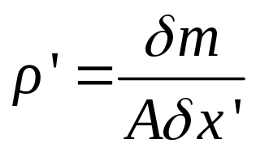
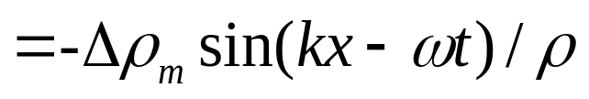

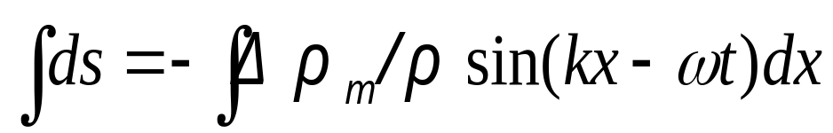
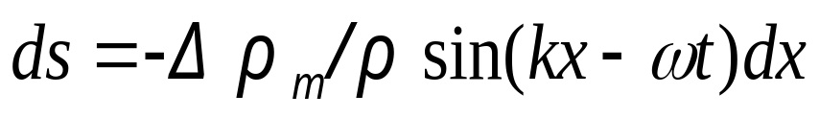
δx
δx’
A
x
s(x+δx)
s(x)

Slide 5
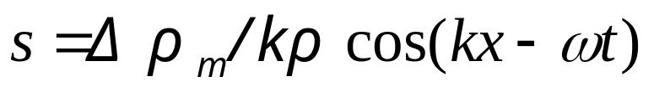
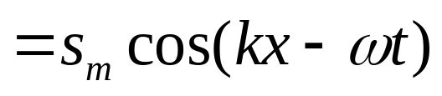
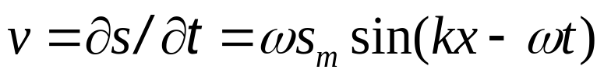


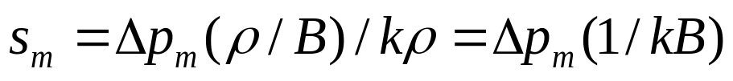
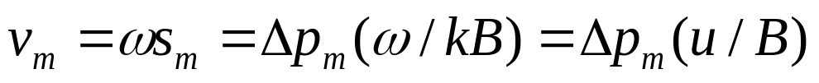
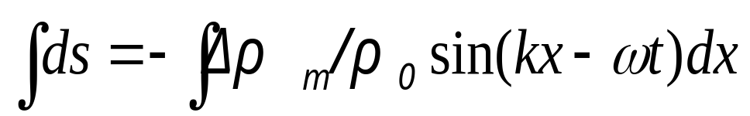
δx
δx’
A
x
s(x+δx)
s(x)
Displacement
Velocity

Slide 6
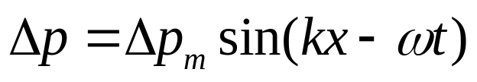

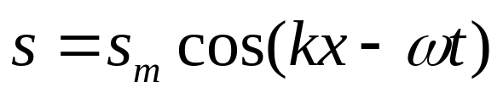
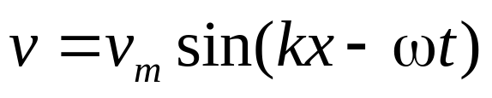
Pressure
Δp
x
density
Δρ
x
s
Displacement
x
v
velocity
x

Slide 7
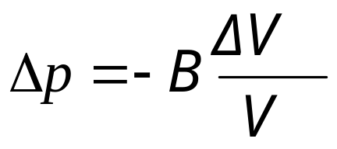
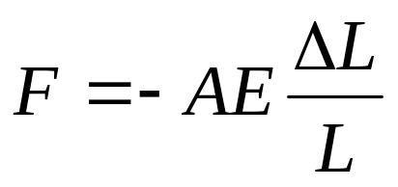
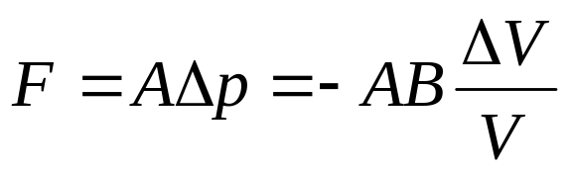


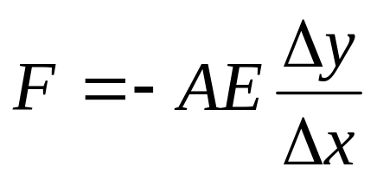
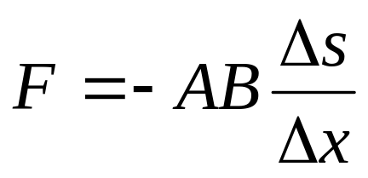
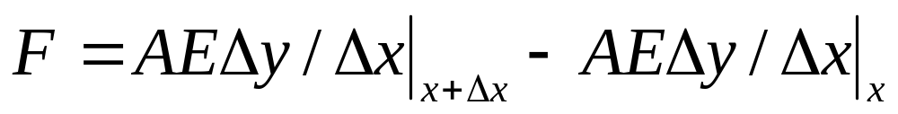
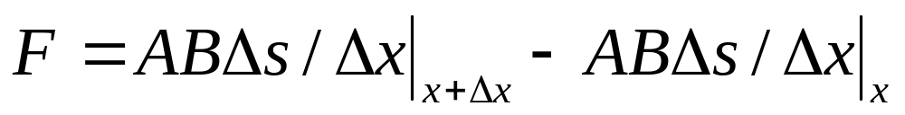
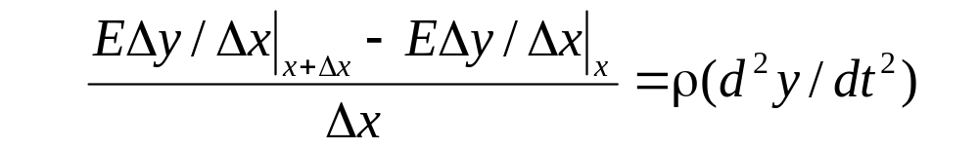
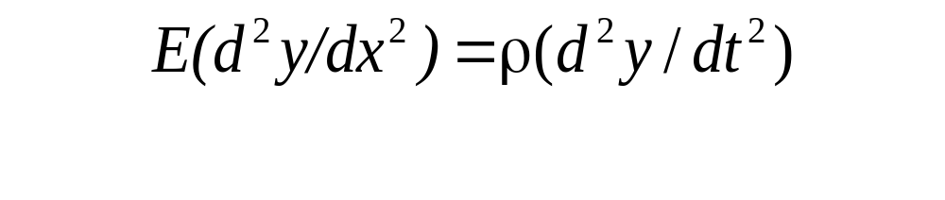
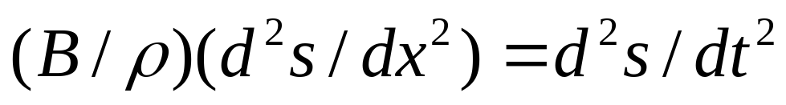
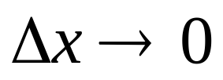

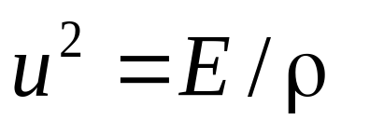
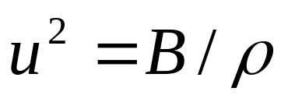

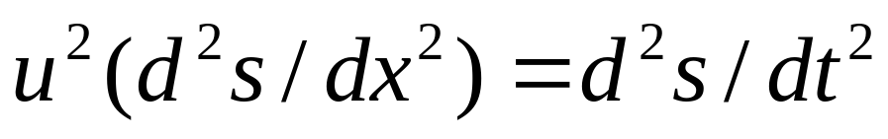
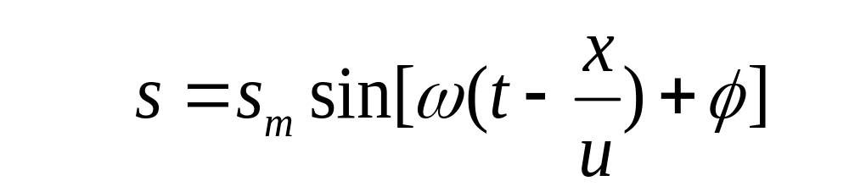
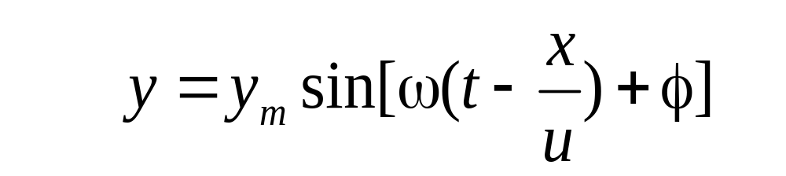

Δy
Δs
Wave Speed
Δx
A
x
x+ Δx
The speed of sound

Slide 8
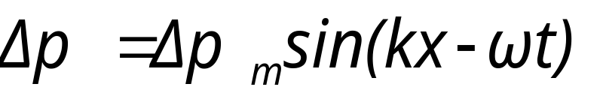
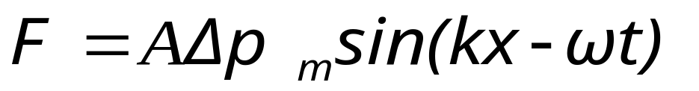
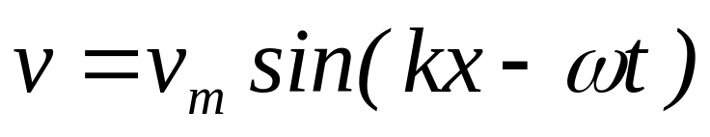
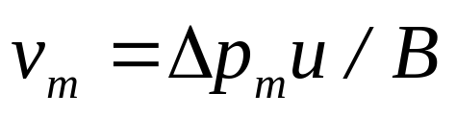
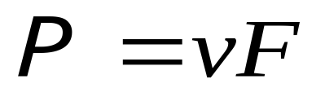
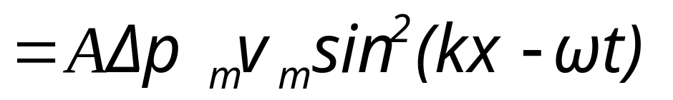
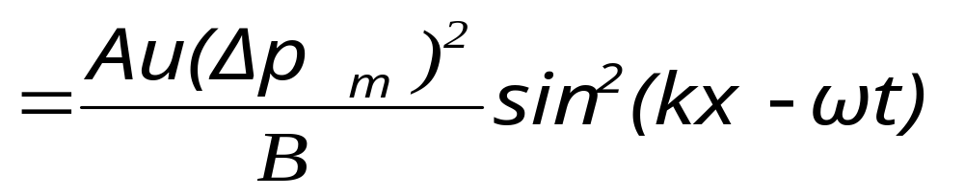
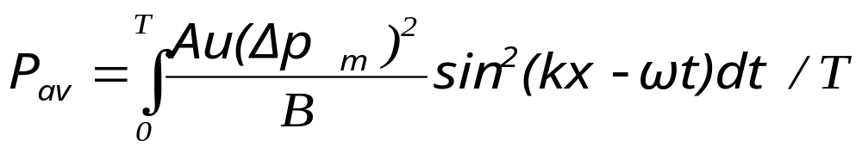
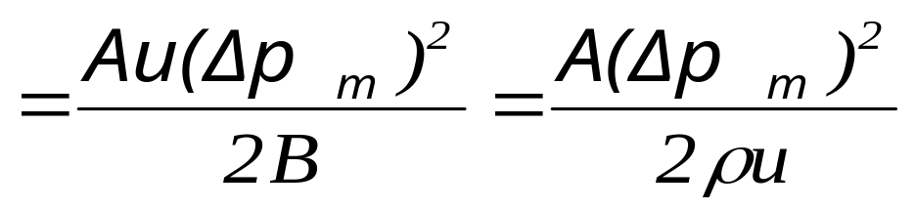
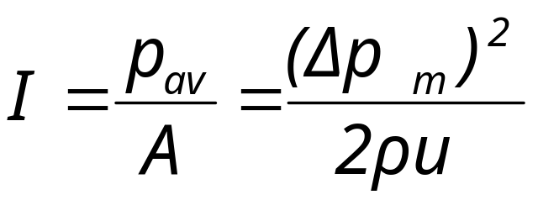
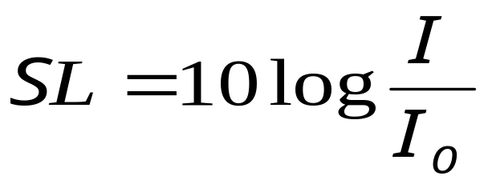
The power of sound
The Average of power
The sound level (SL)
The Intensity

Slide 9
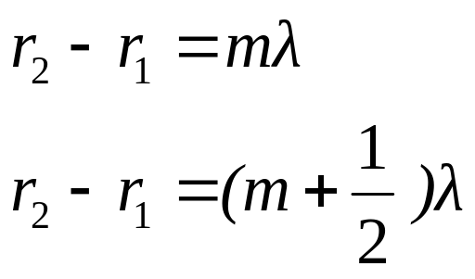
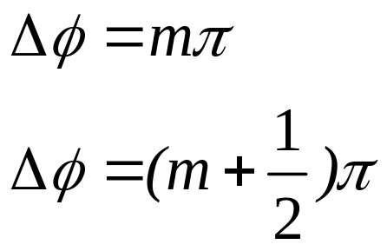








interference
s₁
r₁
p
Max
Min
r₂
s₂
Sound Wave

Slide 10





Resonance

Slide 11





Resonance

Slide 12





Standing Sound Wave
Resonance

Slide 13





Standing Sound Wave
Resonance

Slide 14




Resonance

Slide 15







Beat
Δp₁
t
Δp₂
t
Δp
t

Slide 16





The Doppler Effect
y
u
v
s
x
λ

Slide 17




The Doppler Effect
y
λ’
v
u
u
s
x

Slide 18



Summary
Moving Observer
Moving Source
Moving both

Slide 19

Effect at High Speed
u_{s}>u
supersonic
u
v
u_{s}
s
x

Slide 20



Example

Slide 21













Example

Slide 22





Example

Slide 23

Example

Slide 24





Example

Slide 25
Example
Frame must be fixed with
material medium
Sound in material medium

Slide 26





Example

Slide 27
CHAP. 19 Problems
P449 6, 10
P450 18, 19, 20

